Slide 1

Heredity and Evolution
Mendel’s terminologies

Slide 2

Mendel showed his experiment and results using some specific terminologies.

Slide 3


MENDEL’S TERMINOLOGIES
Character which masks or hides its partner is called as dominant character and the character which gets masked is called as recessive.
For eg
When tall plant is crossed with dwarf plant
In the next generation all plant were tall
Hence, Mendel concluded that tall plant genes dominates the recessive plant genes.

Slide 4
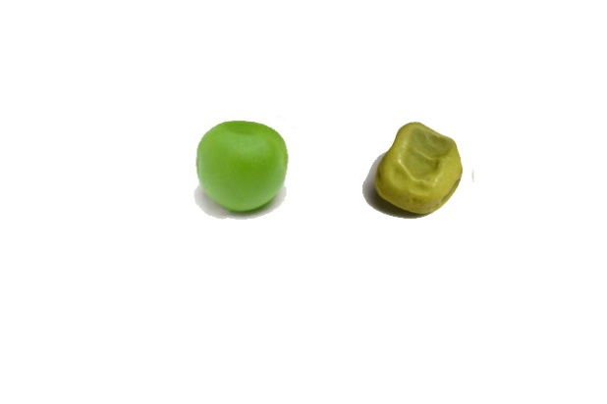
MENDEL’S TERMINOLOGIES
Similarly, Mendel conducted experiments with all the other six characters and he found the following result.
Seed shape
In the next generation all seeds were Round
Round
Wrinkled
Round
Hence, Mendel concluded that round seeds dominates over recessive wrinkled seeds.

Slide 5

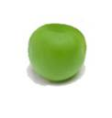
MENDEL’S TERMINOLOGIES
Similarly, Mendel conducted experiments with all the other six characters and he found the following result.
Seed colour
In the next generation all colour of seed were yellow.
Yellow
Green
Yellow
Hence, Mendel concluded that yellow seed is dominant over green seed.

Slide 6
MENDEL’S TERMINOLOGIES
Similarly, Mendel conducted experiments with all the other six characters and he found the following result.
Seed colour
In the next generation all colour of seed were yellow.
Yellow
Green
Yellow
Hence, Mendel concluded that yellow seed is dominant over green seed.

Slide 7
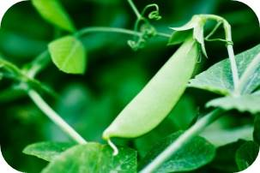
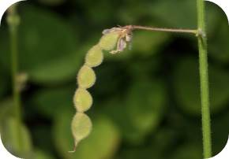

MENDEL’S TERMINOLOGIES
Similarly, Mendel conducted experiments with all the other six characters and he found the following result.
Pod shape
In the next generation all Pod shape were full
Full
Constricted
Full
Hence, Mendel concluded that full is
dominant over constricted pod shape.

Slide 8
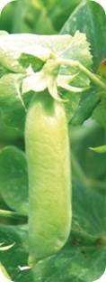
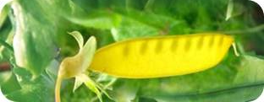
MENDEL’S TERMINOLOGIES
Similarly, Mendel conducted experiments with all the other six characters and he found the following result.
Pod colour
In the next generation all Pod shape were full
Green
Yellow
Green
Hence, Mendel concluded that full is
dominant over constricted pod shape.

Slide 9
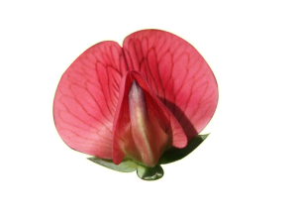
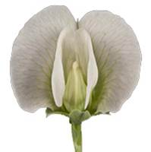
MENDEL’S TERMINOLOGIES
Similarly, Mendel conducted experiments with all the other six characters and he found the following result.
Colour of flower
In the next generation all colour of flower were red
Red
White
Red
Hence, Mendel concluded that red flower is dominant over white flower.

Slide 10
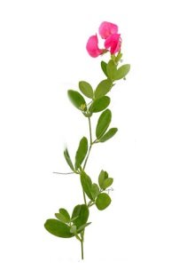
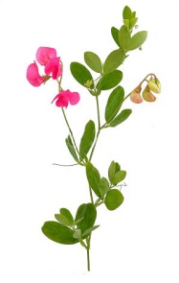
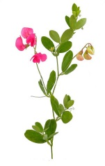
MENDEL’S TERMINOLOGIES
Similarly, Mendel conducted experiments with all the other six characters and he found the following result.
In the next generation position of all flower were axial
Position of flower
Axial
Terminal
Axial
Hence, Mendel concluded that axial flowers are dominant over terminal flower.

Slide 11
Thank You

